Slide 1
The Immediate Effect of Cognitive Defusion in a Clinical Sample: Distress, Believability, and the Role of Psychological Flexibility
Kristy L. Dalrymple, Ph.D.
Brandon A. Gaudiano, Ph.D.
Lia Rosenstein, B.A.
Emily Walsh, B.A.
Association for Contextual Behavioral Science
Seattle, June 2016

Slide 2
Acknowledgements
Grant Funding:
NIMH K23MH085730 (PI: Dalrymple)
Additional Research Assistants/students:
Jennifer Martinez
Elizabeth Tepe
Trevor Lewis
Kathryn Nowlan
Special thanks to Dr. Akihiko Masuda!

Slide 3
Isolating The Defusion Component
Important to isolate components of larger treatment packages to increase understanding of processes (Hayes et al., 2008)
ACT component meta-analysis (Levin et al., 2012):
Large effect sizes for defusion compared to inactive conditions (0.74, 0.77)
Notes:
Although it is important to test the efficacy of larger treatment packages, many of them are complex and include multiple components, making it difficult to determine which components are actively contributing to change. Therefore, researchers recently have emphasized isolating and testing these components separately, to build a better understanding of these processes and further inform treatment development.
A recent meta-analysis on ACT components found that defusion showed large effect size differences with inactive conditions, suggesting that this component is worthy of further investigation

Slide 4
Defusion Experimental Studies
Defusion = greater decreases in distress & believability compared to thought distraction/thought control
(e.g., Masuda et al., 2009;2010; Healy et al., 2008)
Defusion = greater decreases in believability & frequency, and greater increases in willingness compared to cognitive restructuring
(e.g., Larsson et al., 2015)
Notes:
Several studies of defusion in analogue samples have been conducted thus far, utilizing tasks such as vocal repetition or re-statement of thoughts in a defused manner. They have shown that defusion resulted in greater decreases in thought distress and believability compared to control conditions such as distraction or cognitive restructuring.

Slide 5
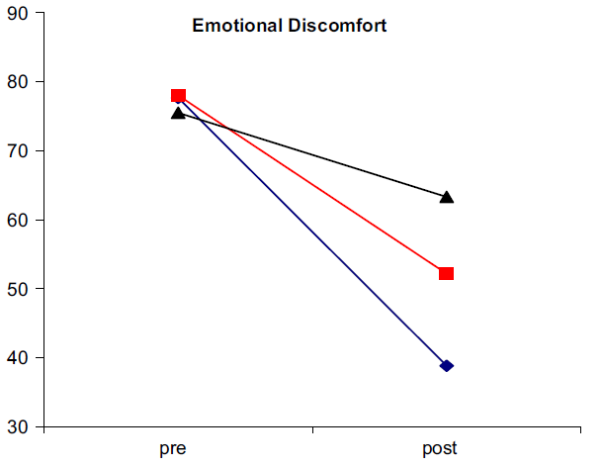
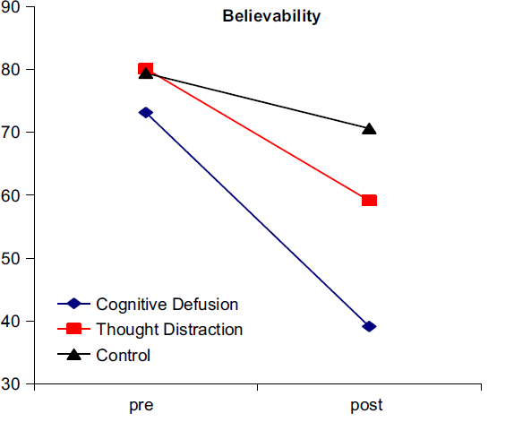
Defusion and Depression Masuda, Twohig, et al. (2010)
Notes:
Although none of these studies have been conducted in clinical samples of individuals diagnosed with depression, some studies have shown that these effects are replicated in subsamples with elevated depression levels. Therefore, there is some evidence to suggest that defusion also is associated with greater reductions in thought distress and believability compared to distraction in participants with depression symptoms.

Slide 6
Current Study Aims
Analyze full sample of individuals with clinical depression
Test immediate effect of defusion on self-relevant negative thoughts compared to distraction
Examine role of psychological flexibility (PF)
Notes:
Previously, we presented intermediate results from this study in a subsample of 74 adults diagnosed with depression. Now we present results from a larger sample of participants diagnosed with a depressive disorder. We sought to test the immediate effect of defusion on self-relevant thoughts compared to distraction, and to examine the role of baseline levels of psychological flexibility on thought distress and believability.

Slide 7
Participants
97 adults with current depressive disorder diagnosis
Exclusions:
Bipolar disorder
Psychosis
Active suicidal ideation
Currently receiving ACT
Notes:
The current sample included 97 adults, who were diagnosed with a depressive disorder (which included major depression, major depression in partial remission, depressive disorder not otherwise specified, and dysthymia)
We kept exclusion criteria minimal. We chose to exclude individuals already receiving ACT, as those individuals may have already been exposed to the defusion strategy used in the current study.

Slide 8
Recruitment
Referred by treatment provider based on diagnosis
Or
Responded to social media ad; then confirmed by brief diagnostic interview (SCID mood & psychosis modules)
Compensated $10 for participation
Notes:
Participants were referred by their treatment provider based on their chart diagnosis, or they self-referred based on a Craig’s List ad. For those recruited from Craig’s List, their eligibility was confirmed using the SCID mood and psychosis modules. All participants were compensated $10 for their participation.

Slide 9
Assessment Schedule
Measure | Baseline | Post-Task1 | Post-Task2
Demographics Form | X
CUDOS (depression severity) | X
AAQ-II (psychological flexibility) | X
Thought Distress & Believability Ratings | X | X | X
Notes:
Questionnaires were given at baseline, including a measure of depression and psychological flexibility. Thought distress and believability ratings were given at baseline and after each task.

Slide 10
General Procedures
Initial Thought Selection
Pick a thought that is repeated, distressing, believable (at least moderate severity)
Randomly Assigned to:
Standard Cognitive Defusion
Enhanced Cognitive Defusion
Thought Distraction
Notes:
After consented, participants were asked to recall a thought that occurs to them repeatedly, that they find distressing and believable. The experimenter then worked with the participant to condense the thought into 1 word or a very short phrase (such as, “failure” or “worthless”). To ensure sufficient thought severity, they were required to have rated the thought as being at least moderately severe. Participants were then randomly assigned to one of three conditions: standard cognitive defusion, an enhanced cognitive defusion, or thought distraction. For the purposes of the current analyses, the two defusion conditions were combined.

Slide 11
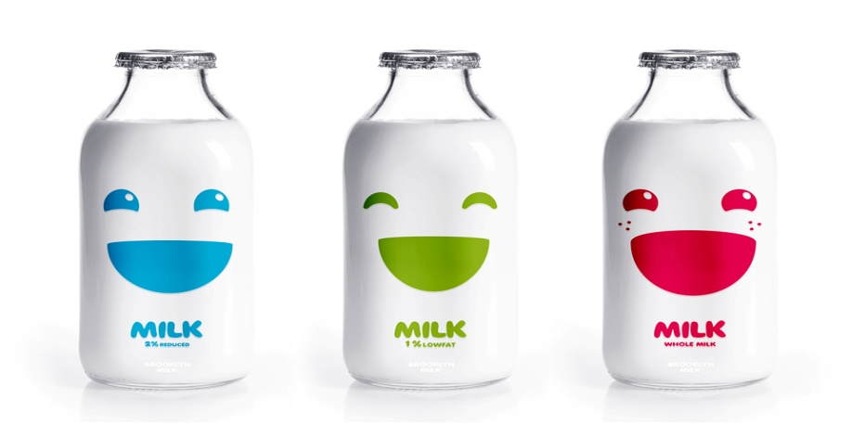
Cognitive Defusion
Rationale and training with “milk”
Task 1: repeat self-relevant word for 20 sec.
Task 2: one of two defusion exercises:
Same as Task 1 (self-relevant word repetition)
Listening to a recording of self-relevant word repetition played back with a “helium” effect.
Notes:
Participants in the defusion condition were provided with a rationale for defusion based on the original ACT book (Hayes et al., 1999), and previous studies by Dr. Masuda and colleagues. They then were “trained” on the word milk as in the original ACT book, and conducted the same vocal repetition exercise with the self-relevant word. They repeated that exercise again for Task 2. Those in the enhanced defusion condition conducted the same exercises, with the exception that for Task 2 a recording of their Task 1 vocal repetition was played back in a helium voice.

Slide 12
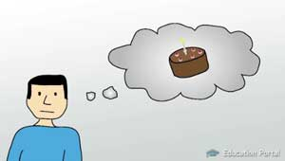
Thought Distraction
Rationale and training with “milk”
Task 1: distract from self-relevant word for 20 sec.
Task 2: distract again
Notes:
Participants in the distraction condition received a rational for distraction based on the emotion regulation literature and Dr. Masuda’s prior studies. They then were trained on distraction with the word milk, and conducted two trials of distracting from their self-relevant word.

Slide 13
Sample
72% female
77% Caucasian
M Age = 41
45% never married, 32% married/cohabitating
43% HS/GED as highest degree
51% employed, 34% unemployed/disability
Conditions:
Defusion n = 66 (combined the 2 defusion conditions)
Distraction n = 34
Notes:
The majority of the sample was female and Caucasian, with a third being unemployed or on disability. In the current analyses, the 66 participants in the 2 defusion conditions were combined; 34 participants were assigned to the distraction condition.

Slide 14
Primary Analyses
Hypothesis #1: Overall, defusion will result in lower thought distress and believability ratings compared to thought distraction
Notes:
For the primary analyses, our first hypothesis was that defusion would result in lower thought distress and believability compared to the distraction condition. Next, we present preliminary findings mainly by examining differences in effect size within and between conditions for the defusion vs distraction tasks.

Slide 15
Thought Distress
Notes:
On thought distress, you can see that participants in the defusion conditions reported somewhat lower thought distress by Task 2 compared to the distraction participants.

Slide 16
Thought Believability
Notes:
And the same was also true for ratings of thought believability

Slide 17
Within-Group Effect Sizes for Defusion and Distraction
Distress
Believability
Notes:
When examining within-group effect sizes, both groups showed large effect size change over time from baseline to task 1 and baseline to task 2. However, these effect sizes were somewhat larger for the defusion condition for both thought distress and believability.

Slide 18
Between-Group Effect Size Differences for Thought Distress and Believability
Notes:
Effect size differences between defusion and distraction conditions at Task 1 and Task 2 were small in magnitude and favored the defusion conditions. The largest effect size difference was on thought believability at Task 1, with the defusion condition reporting lower believability compared to the distraction condition.

Slide 19
Role of Psychological Flexibility
Hypothesis #2: Psychological flexibility will moderate the effects of condition on distress and believability.
Thought Distraction Condition:
Higher psychological inflexibility at baseline associated with less change between Task1 and Task2
Distress: r = -.49 (p = 0.004)
Believability: r = -.41 (p = 0.02)
Notes:
Our second hypothesis was that baseline psychological flexibility would moderate the effects of condition on distress and believability. To begin to look at this, we examined whether baseline levels of psychological flexibility would be associated with change in distress and believability over time. We found that in the distraction condition only, higher levels of psychological inflexibility at baseline were associated with less change in distress and believability between Task 1 and Task 2, with medium size correlations.

Slide 20
Role of Depression
Baseline Depression Severity (CUDOS M = 34.65; moderate severity)
No difference between groups
In Distraction Condition Only:
AAQ predicted change in distress between Task1 and Task2 controlling for depression scores
AAQ predicted change in believability between Task1 and Task2 controlling for depression
Notes:
Overall, depression severity in the sample was in the moderately severe range, with no difference between conditions on baseline depression severity. In the distraction condition only, the relationship found between higher AAQ scores and change between Task 1 and 2 on distress and believability held when controlling for depression scores in a regression analysis.

Slide 21
Psychological Inflexibility As A Possible Moderator
AAQ median split :
Median = 34; Mean = 33.5
AAQ<34 n=43
AAQ >34 n=52
(higher scores = greater inflexibility)
Notes:
To examine the role of psychological flexibility further, we conducted a median split on the AAQ and examined distress and believability at lower and higher levels of the AAQ. There were 43 participants below the median, and 52 at or above the median.

Slide 22
AAQ Median Split: Distraction Condition
Distress
Believability
Notes:
In the distraction condition, participants with higher baseline AAQ scores (greater inflexibility) appeared to have less change in distress and believability by Task 2 compared to participants with lower AAQ scores.

Slide 23
AAQ Median Split: Defusion Condition
Distress
Believability
Notes:
However, in the defusion condition, there seemed to be no difference between those with lower or higher baseline AAQ scores by Task 2 on thought distress or believability.

Slide 24
Within Group Effect Size Change: Distraction Vs. Defusion
Distress
Believability
Notes:
We examined within group effect sizes by AAQ median split. Within the distraction condition, participants with higher AAQ scores (greater inflexibility) had lower effect size change on thought distress and believability compared to participants with lower AAQ scores. In contrast, in the defusion conditions, effect size changes were more comparable on thought believability and distress regardless of AAQ scores.

Slide 25
Discussion
Primary analyses:
Defusion showed lower thought distress and believability compared to distraction condition
Thought Distress: Small effect size differences between conditions
Thought Believability: Small-medium effect size differences between conditions
Notes:
To summarize, defusion resulted in lower thought distress and believability by Task 2 compared to distraction. Effect size differences between conditions were small for thought distress, and small to medium for thought believability.

Slide 26
Discussion
Preliminary evidence for psychological flexibility as moderator of effects:
In distraction condition only:
Higher inflexibility at baseline associated with less change in distress and believability
Lower inflexibility associated with greater change in distress and believability
Held even when controlling for depression severity
In defusion condition:
Higher and lower inflexibility groups showed similar (large) improvements in distress and believability
Notes:
Furthermore, we found evidence that psychological flexibility was a possible moderator of the relationship between condition and thought distress/believability. More specifically, higher levels of baseline psychological inflexibility were associated with less change in distress and believability while lower levels were associated with more change, but in the distraction condition only. This relationship held when controlling for baseline depression severity, indicating that this association was not due simply to initial level of distress. Furthermore, participants in the defusion condition showed similar, large improvements in distress and believability regardless of baseline level of psychological flexibility.

Slide 27
Implications
Cognitive defusion strategies are effective for managing depressive thoughts regardless of their level of psychological inflexibility.
Use of thought distraction may be particularly problematic and ineffective for depressed clients who are also high in psychological inflexibility.
Notes:
Results from the current study provide additional evidence that defusion strategies may be more effective at reducing thought distress and believability compared to distraction strategies. In addition, defusion strategies are effective at doing so regardless of the level of psychological flexibility
Results also indicate that especially for individuals who are depressed and report high levels of psychological inflexibility, distraction strategies may be ineffective.

Slide 28
Limitations
Brief defusion techniques may have limited/temporary impact on depressive thoughts.
Additional statistical testing of moderation indicated.
Only small to medium effect size differences between defusion and distraction conditions.
Notes:
Although these effects were found, they may be limited to only short periods of time. Future studies should continue to examine whether these strategies could have longer-term impacts
In addition, we plan to conduct additional analyses to formally test psychological flexibility as a moderator of effects on thought believability and distress.
Finally, between groups effects were small and analyses were preliminary; therefore, this should continue to be studied in larger clinical samples of individuals diagnosed with depression. However, results were consistent with prior studies that have examined defusion effects in subsamples with elevated levels of depression symptoms.

Slide 29
Future Directions
Plan to examine differences between the two defusion conditions
Cognitive restructuring as comparison rather than thought distraction
Yovel et al. 2014:
Restructuring vs. defusion after mood induction
Similarly effective in improving mood
But operated through different appraisal vs. acceptance mechanisms
Take-home component: practice on own, come back for follow-up
Notes:
For the current analyses, we combined the two defusion conditions, but we plan to conduct further analyses in the future to examine the incremental effect of the enhanced defusion task.
In addition, most of the prior studies have utilized distraction as the comparison condition. Moving forward, more studies should be conducted utilizing components from other empirically-supported treatments that may have some philosophical/conceptual differences, such as cognitive restructuring in CBT. A few such studies have been conducted, such as by Yovel and colleagues, which found that although both showed similar improvements in mood, they operated through different mechanisms that were theory-consistent (in other words, appraisal for restructuring strategies and acceptance for defusion strategies).
Finally, future studies should examine the effects of additional home practice, to determine whether continued practice could lead to longer-term effects.

Slide 30
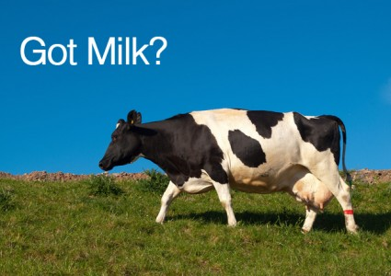
Notes:
Thank you for your time and attention! These slides will be available on the ACBS website, and feel free to contact Dr. Dalrymple with any questions.

